Slide 1

Navigating the World of Computer Networks
Understanding the core components, protocols, and architecture of computer networks is essential for a successful digital future.

Slide 2
Essential Network Devices: A Comprehensive Overview
Modem
RJ-45
NIC
Hub
Connects your network to the internet, converting digital signals to analog and vice versa.
A common network connector that allows devices to connect to each other and the network.
Network Interface Card enables devices to communicate with a network.
Simple device that broadcasts data to all connected devices, inefficient for large networks.

Slide 3
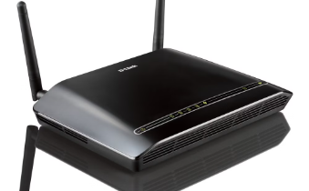
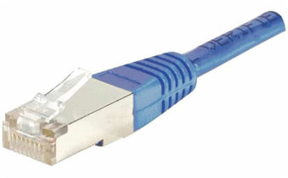
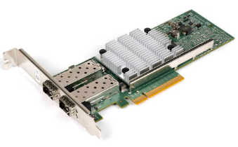
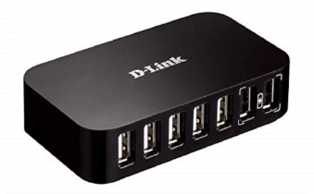
Modem
RJ - 45 Wire
NIC (Network Interface Card)
Hub

Slide 4
Network Devices: Beyond the Basics
Switch
Repeater
Bridge
Router
Intelligent device that directs data traffic to specific devices, improving efficiency and performance.
Amplifies network signals to extend the reach of a network.
Connects two networks together, allowing devices on separate networks to communicate.
Manages traffic between different networks, directing data packets to their destinations.

Slide 5
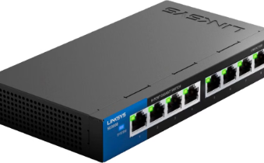
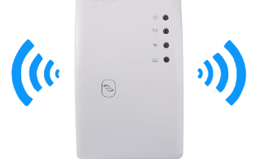
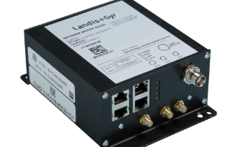
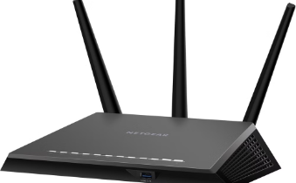
Switch
Repeater
Bridge
Router

Slide 6
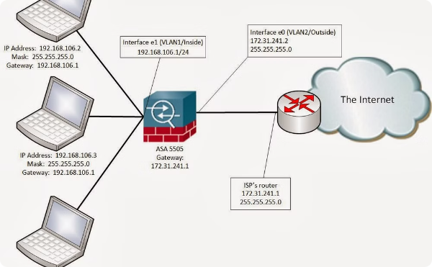
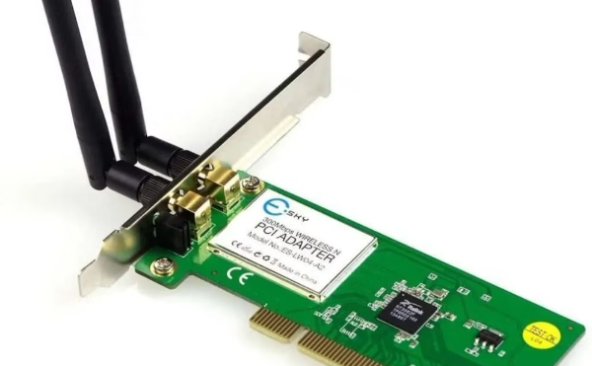
Gateway
Wi-Fi Card
Device connects dissimilar networks: A node on a network that serves as an entrance to another network.
either an internal or external LAN adapter with a wire-less radio and antenna.

Slide 7
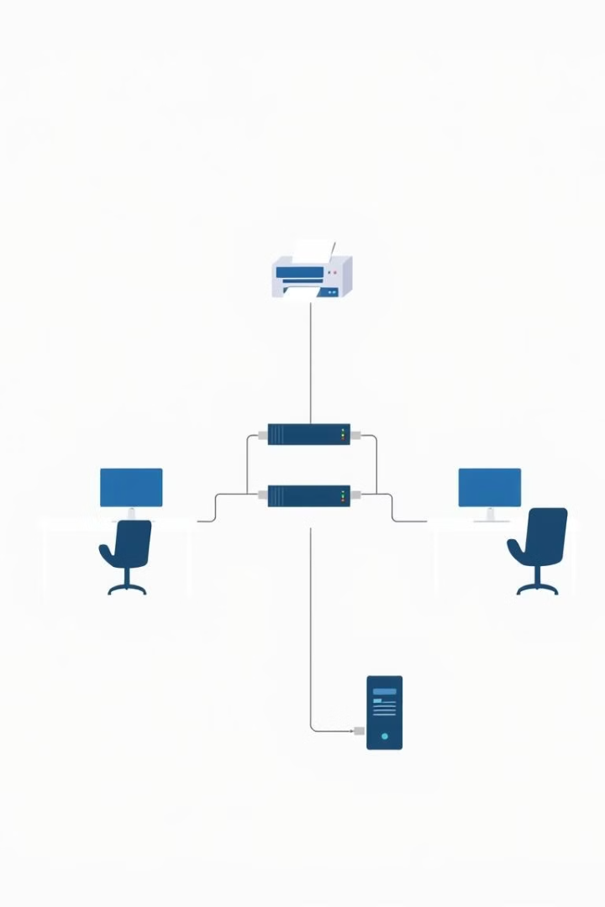
Building a Small Local Area Network (LAN)
1
Planning
Define the network's purpose, size, and requirements.
2
Equipment
Select appropriate network devices, such as a router, switch, and network cables.
3
Configuration
Configure network settings, including IP addresses and network security.
4
Testing
Verify network connectivity and performance after setup.

Slide 8
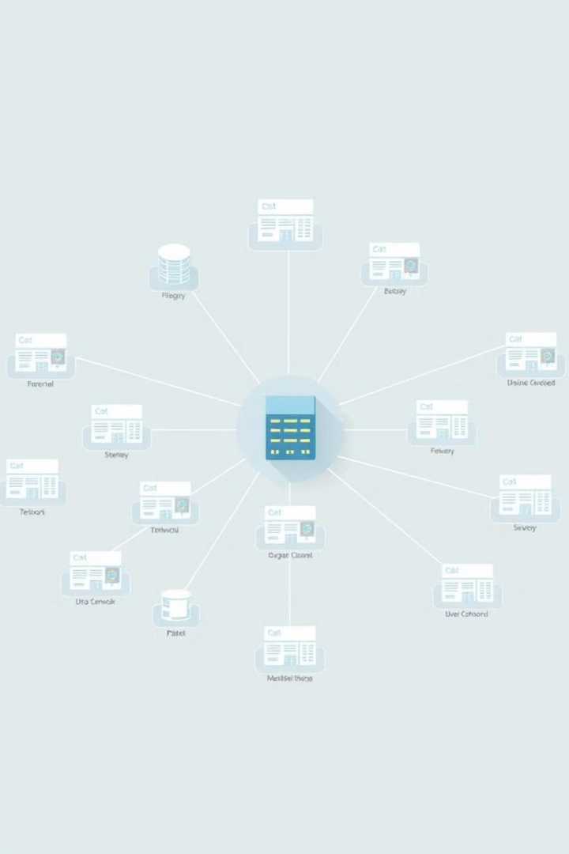




Connecting Offices and Departments
Network Segmentation
Separate departments into smaller, manageable networks for improved security and efficiency.
VLANs
Virtual Local Area Networks (VLANs) allow for logical grouping of devices, regardless of physical location.
Routing
Routers direct data packets between network segments, ensuring data flow between departments.
Centralized Management
Utilize centralized network management tools for easier configuration and monitoring.

Slide 9

Essential Network Protocols
HTTP
HTTPS
Hypertext Transfer Protocol for transferring web pages and other web resources.
Secure version of HTTP, using encryption to protect data transmitted over the internet.
FTP
File Transfer Protocol allows for transferring files between computers over a network.

